Slide 1


Constraint Satisfaction Problem
Team Members:
Name | Roll No. | PRN
Chaitanya Undale | 381063 | 22211103
Vaibhav Chavhan | 381065 | 22210057

Slide 2

Introduction
Definition:
Constraint Satisfaction Problems (CSPs) are a class of computational problems where the goal is to find a solution that satisfies a set of constraints. These constraints impose restrictions on the values of the variable.
Significance of CSP in AI:
CSP is useful in wide range of real-world scenarios in which decision-making is subject to specific conditions and constraints.
CSPs provide a structured and general framework for representing and solving problems, making them adaptable in problem-solving applications.
Many AI applications, such as scheduling, planning, and configuration, can be mapped to CSPs, allowing AI systems to find optimal solutions efficiently.
Common Applications:
Scheduling: Assigning resources like employees or equipment while respecting time and availability constraints.
Planning: Organizing tasks with specific deadlines or sequences.
Resource Allocation: Distributing resources efficiently without overuse.

Slide 3
Key Elements of CSPs:
Objective
to find values to variables such that all constraints are satisfied
Variables
Entities that need to be assigned values.
Domains
Possible values each variable can take.
Constraints
Rules that restrict which combinations of variable assignments are valid.

Slide 4

Examples of CSPs
Sudoku:
Variables: Empty cells in the grid
Domain: Numbers from 1-9
Constraints: Each number must appear exactly once in each row, column, and 3x3 sub-grid.
2. N-Queens problem:
Variables: Positions of queens on an n*n chessboard.
Domain: Possible row and column positions.
Constraints: No two queens can share the same row, column, or diagonal.
3. Timetable scheduling:
Variables: Classes or subjects to be scheduled.
Domain: Available time slots and classrooms.
Constraints: No teacher or classroom can be assigned to two classes at the same time.

Slide 5
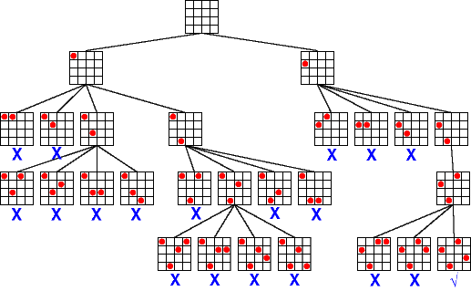
Backtracking Algorithm
The backtracking algorithm is a depth-first search method used to systematically explore possible solutions in CSPs. It operates by assigning values to variables and backtracks if any assignment violates a constraint.
Steps in Backtracking :
Select a variable: Pick a variable that hasn’t been assigned a value yet.
Assign a value: Choose a value from the domain of the selected variable.
Check constraints: Verify if the current assignment violates any constraints.
Backtrack if necessary: If any constraint is violated, undo the previous assignment and try a different value.
Advantages:
Complete: Guaranteed to find a solution if one exists.
Simple and Easy to Implement: Relatively straightforward algorithm.
Disadvantages:
Inefficient for Large CSPs: Backtracking can be slow and may explore unnecessary branches of the search space.
High Time Complexity: The search space grows exponentially with the number of variables.

Slide 6
Wolf, Goat, Cabbage Problem
Variables:
Farmer’s position
Wolf's position
Goat's position
Cabbage's position
Domain:
{left, right}
Constraints:
Wolf and goat should not be at same side when farmer is on opposite side.
Goat and cabbage should not be at same side when farmer is on opposite side.
Farmer can travel with 0 or 1 items.
Initial State: All items on the left side
Goal State: All items on the right side
Demo Game

